Slide 1
Indigenous peoples’ fellow 2019-2020
Presented by Barsha Lekhi, Nepal

Slide 2
Description
National Indigenous Peoples Fellowship, Nepal.
Total grant of the fellowship – 20,000 USD
Focal Area: Indigenous Peoples
Started on June 2019 to December 2020 ~ 19 months
Total beneficiaries: 82 ; 8 direct, 74 through training and capacity building programs.

Slide 3
MAIN OBJECTIVE
a. aims to develop capacity of IP fellow and strengthen IP institutions in Nepal
b. Increase the portfolio of projects led by indigenous peoples, within the SGP
c. Demonstrate modalities for grant-making which are governed with the direct involvement of indigenous peoples.

Slide 4
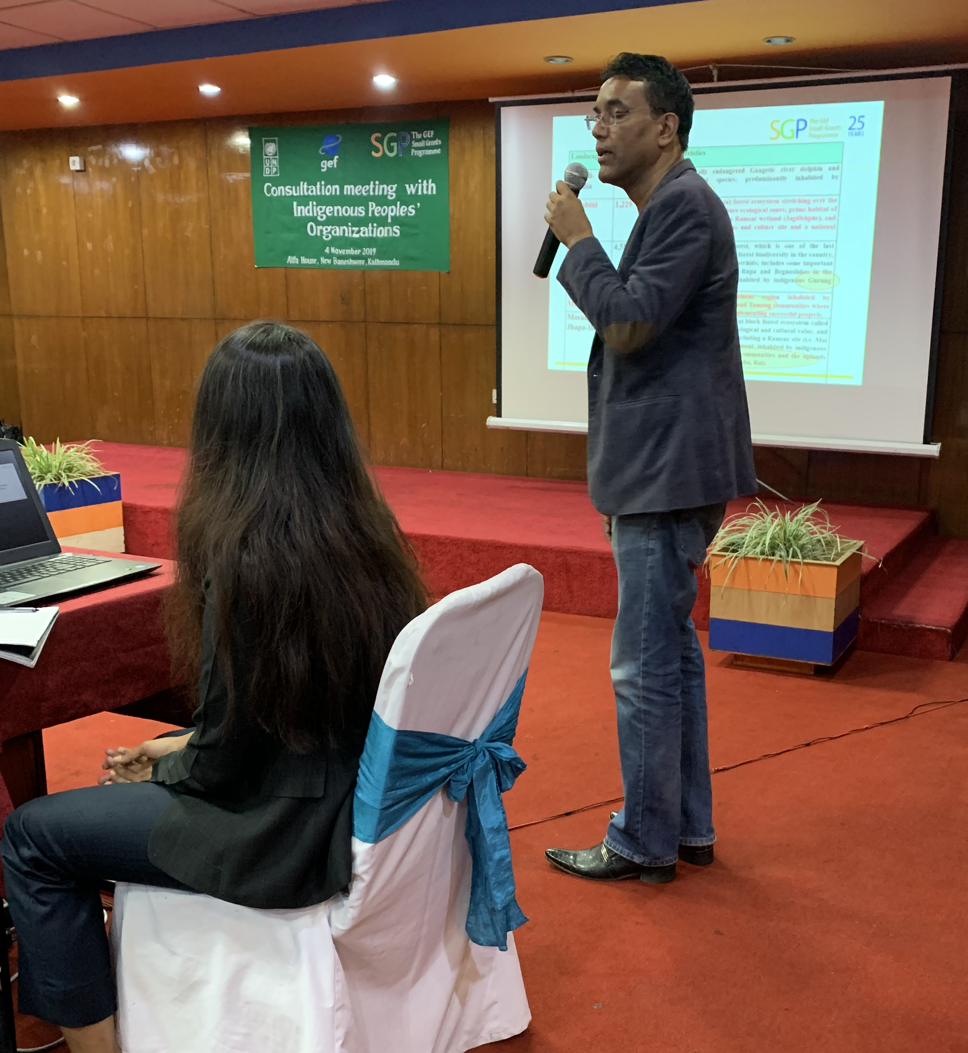
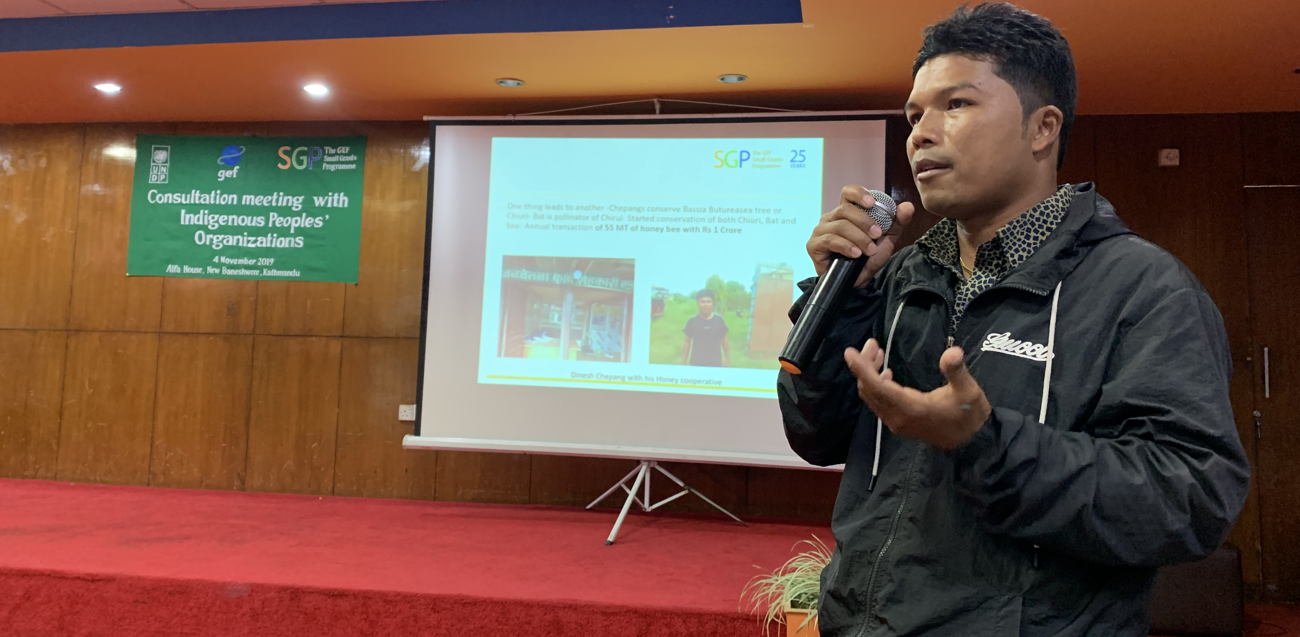
Organized a Consultation meeting with IPOs
demonstrated modalities for grant making with direct involvement of IP,
shared the status of Indigenous Peoples' Profile,
shared the ongoing SGP project to IPOs for easy and clear understanding

Slide 5
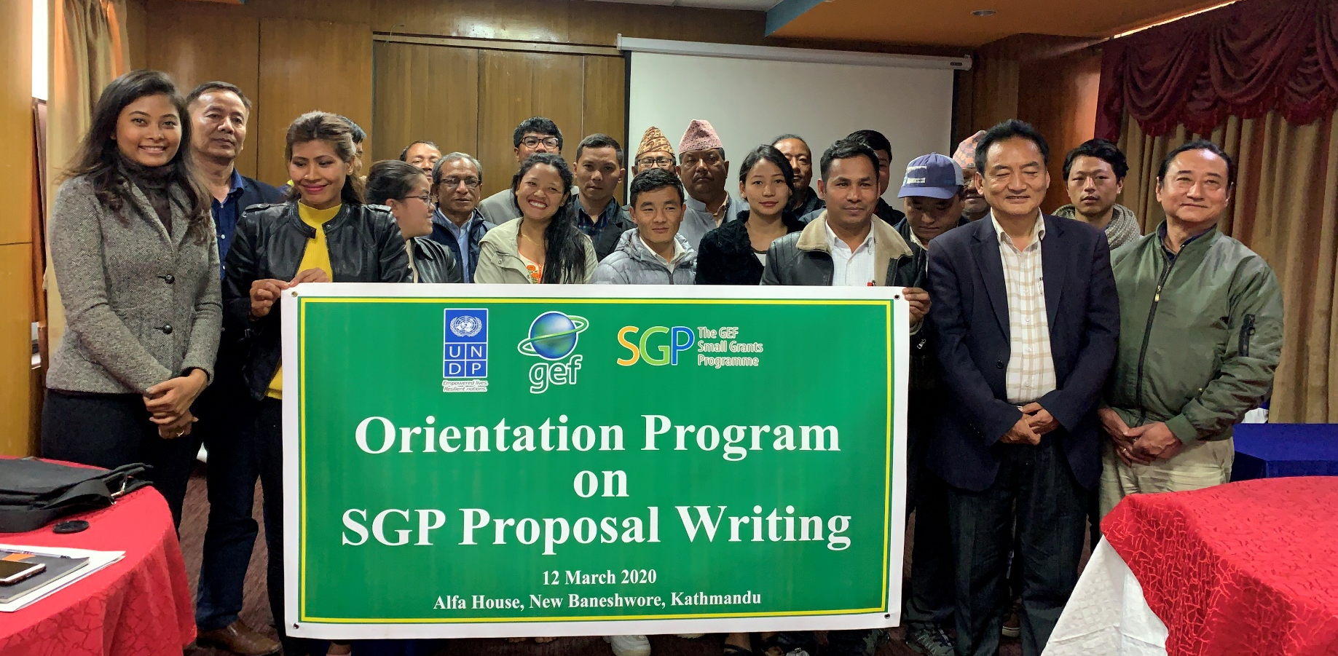
Orientation Program on
SGP Proposal Writing
given to different IP organizations in Nepal.
Shared entrepreneurial learnings from "Regional Dialogue on Indigenous Youth Social Entrepreneurship"

Slide 6
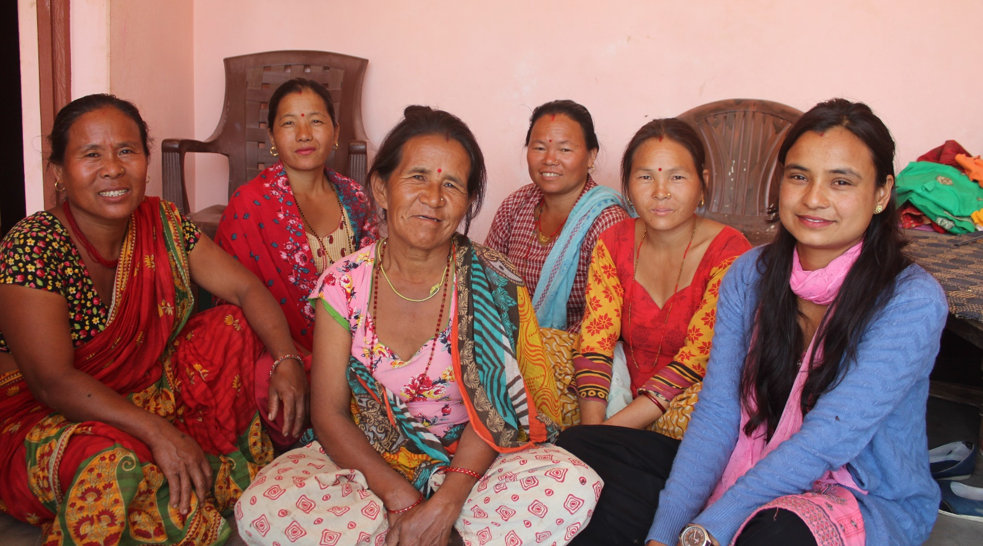
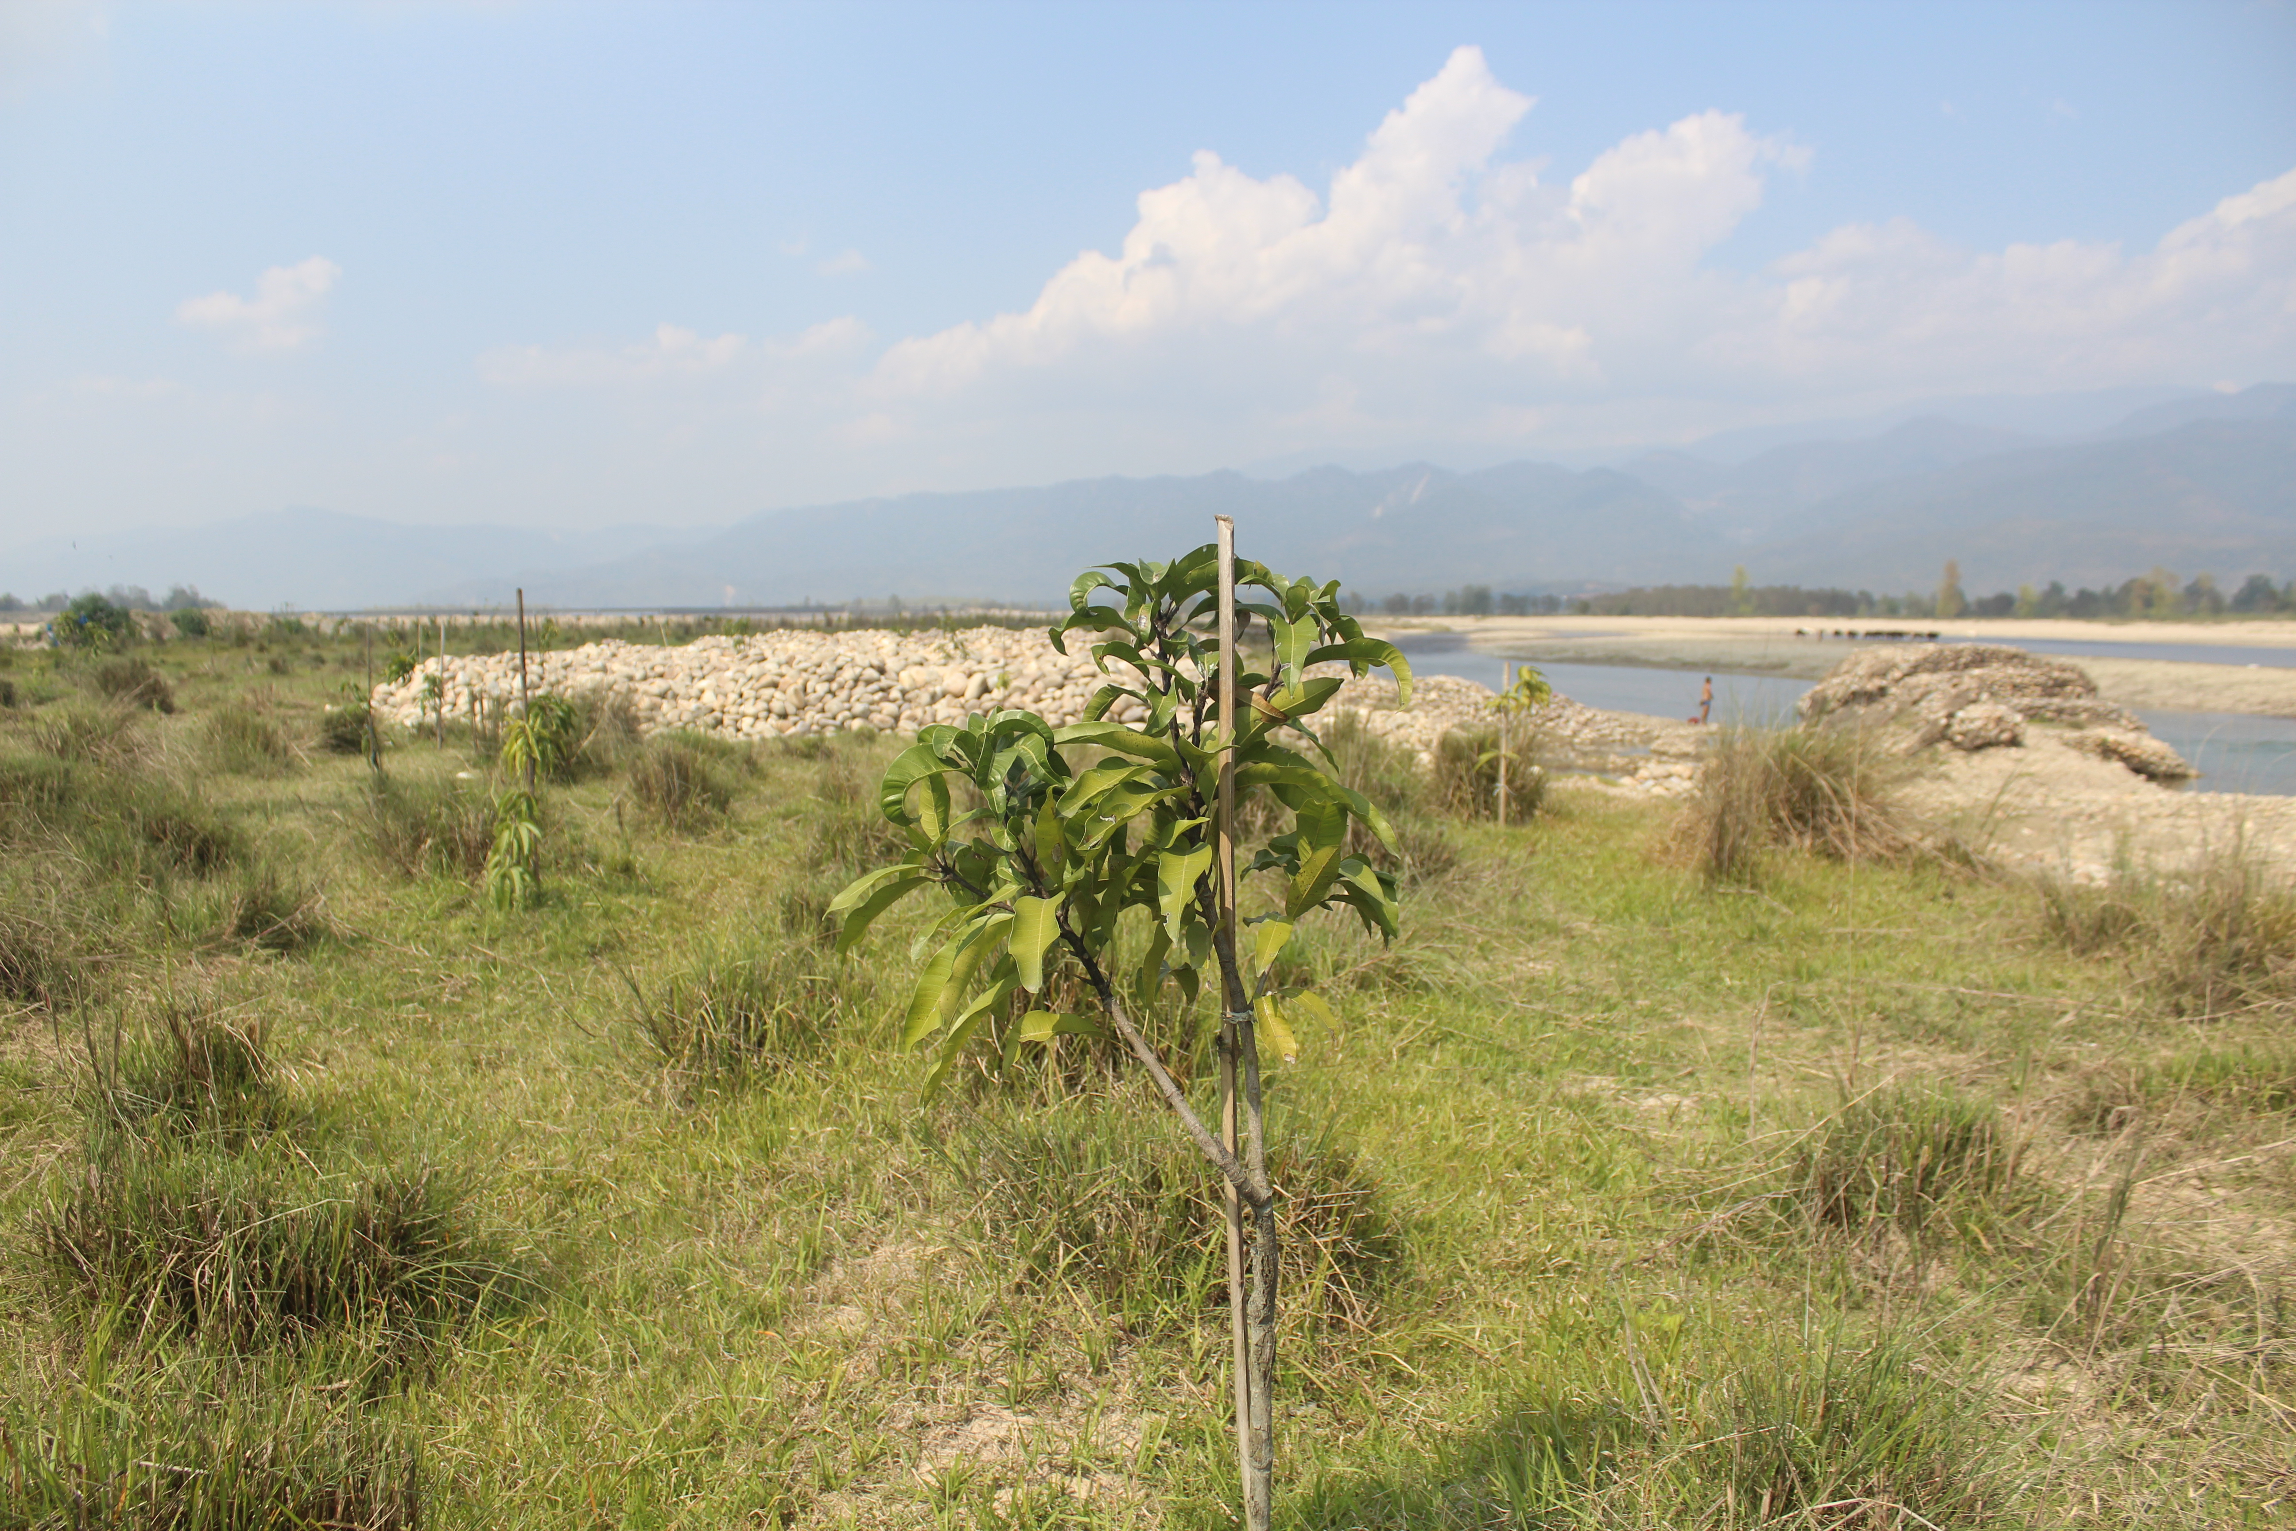
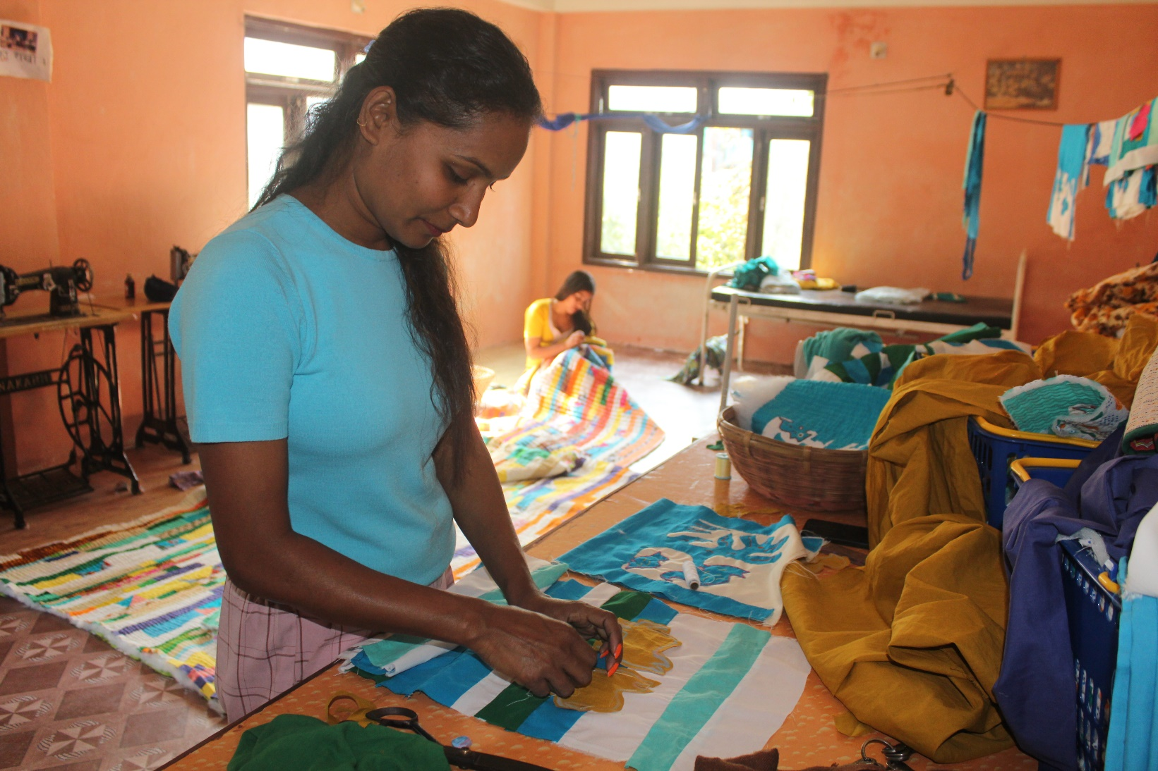

Slide 7
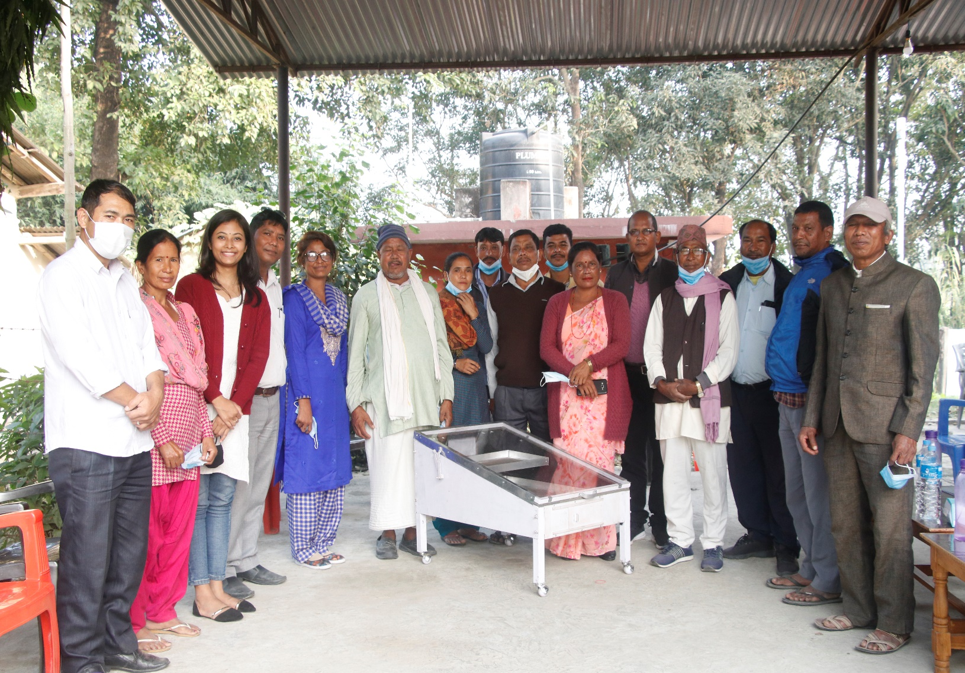
Supported Baidhawa with Solar Dryer
Alternative renewable energy to IPs to meet their needs
One way to combat cc effects- shift to solar energy (renewable energy technology)

Slide 8
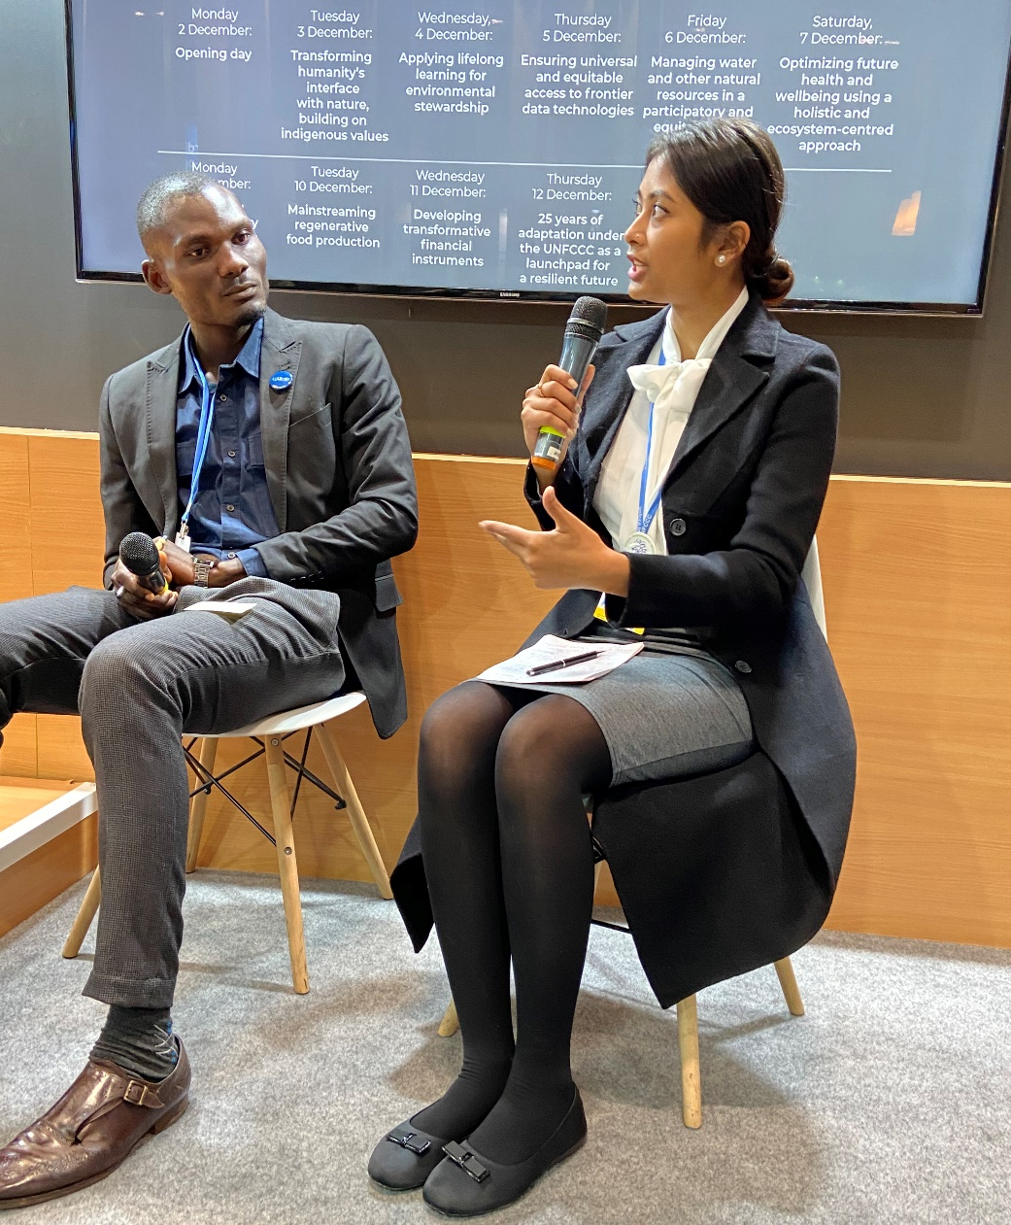
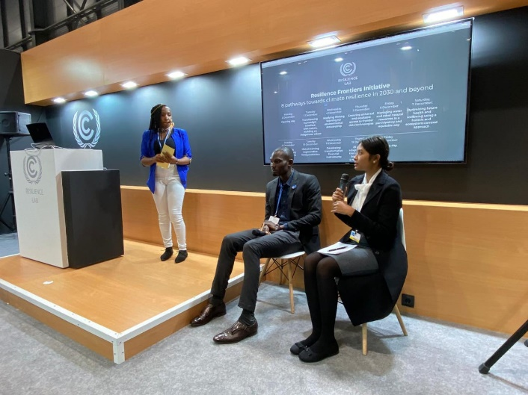
Participation in International workshops
Attended COP 25, Madrid Spain
Participated in Pre-cop Panel discussion by Nepalese Youth for Climate Action (NYCA)
Pictures from Panel discussion on "Transforming humanity's interface with nature, building on indigenous values" in Resilience Lab.

Slide 9
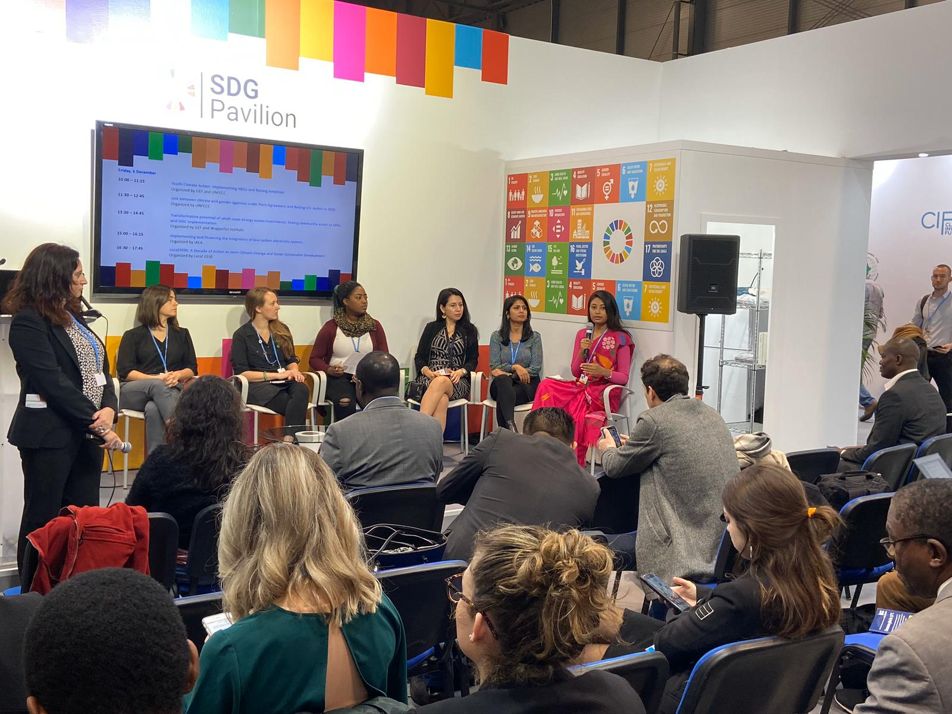
Joined Panel discussion as one of the panelist on "NDC implementation and raising ambition".
Gave my views on how engaging IP in NDC can be milestone for achieving the NDC ambition.
Also talked about GEF SGP projects and IP scenario in Nepal.

Slide 10
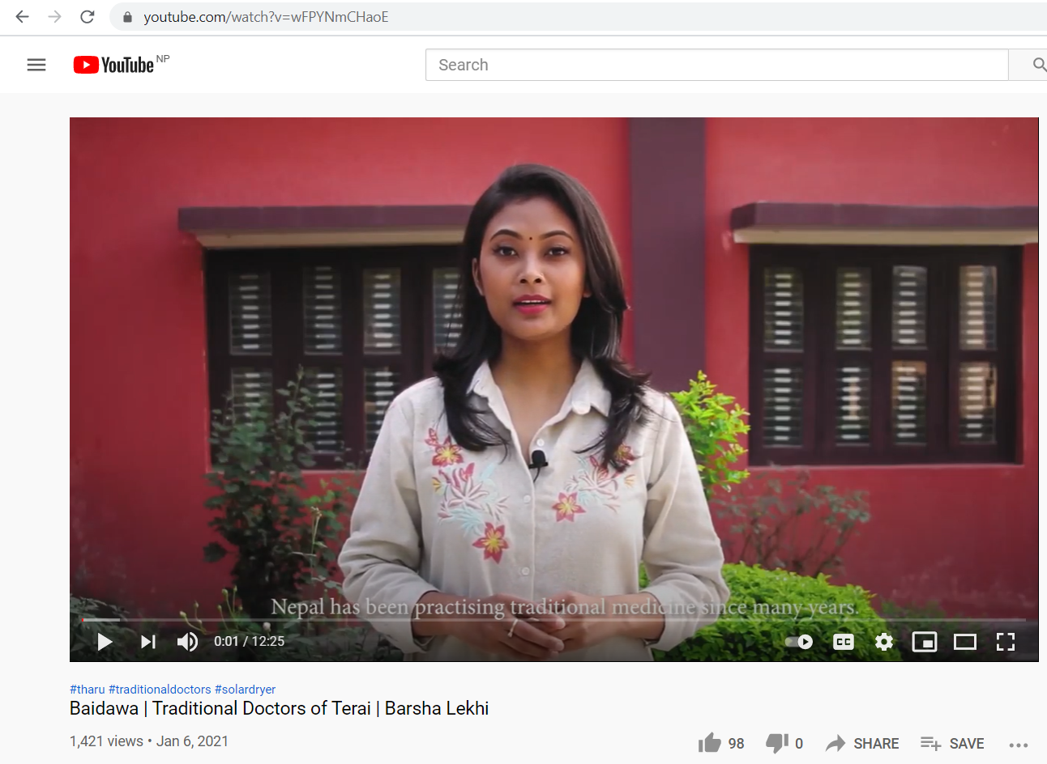
Video documentation
Baidawas were interviewed during the solar distribution program in Bardia.
The interviews were compiled in a documentary video which can be published in YouTube and other social media platforms.
https://www.youtube.com/watch?v=wFPYNmCHaoE

Slide 11
LEARNINGS
Attending international workshops like COP 25, and RDIYSE was entirely a new experience and exposure.
Learnt about Indigenous issues from various landscapes (land, marine, and mountain).
helped in building networks and communication- able to work in a project of UNESCO and AIPP.
gave the idea of leading/directing an indigenous social enterprise. Learnt about business skills: branding, marketing and e-commerce skills.

Slide 12
FUTURE PLANS
Work under SGP projects directly or indirectly
Promote SGP products/services like improved cooking stoves, 3D printing, aquaponics, smart village concept, homestay, etc. – larger audience in my social media handles.
Entrepreneur : Aluminum recycled jewelry (beer/red bull cans) Waste to ornaments

